Slide 1



SENTIMENTAL ANALYSIS

Slide 2

INTRODUCTION
Social media platforms, such as Facebook, have transformed the way we communicate, share experiences, and express our thoughts.
Sentiment analysis, at its core, is the process of determining the sentiment behind a piece of text—whether it's positive, negative, or neutral.
It's a powerful tool that goes beyond just understanding words; it delves into the emotions, attitudes, and opinions embedded in the language used by individuals online.

Slide 3
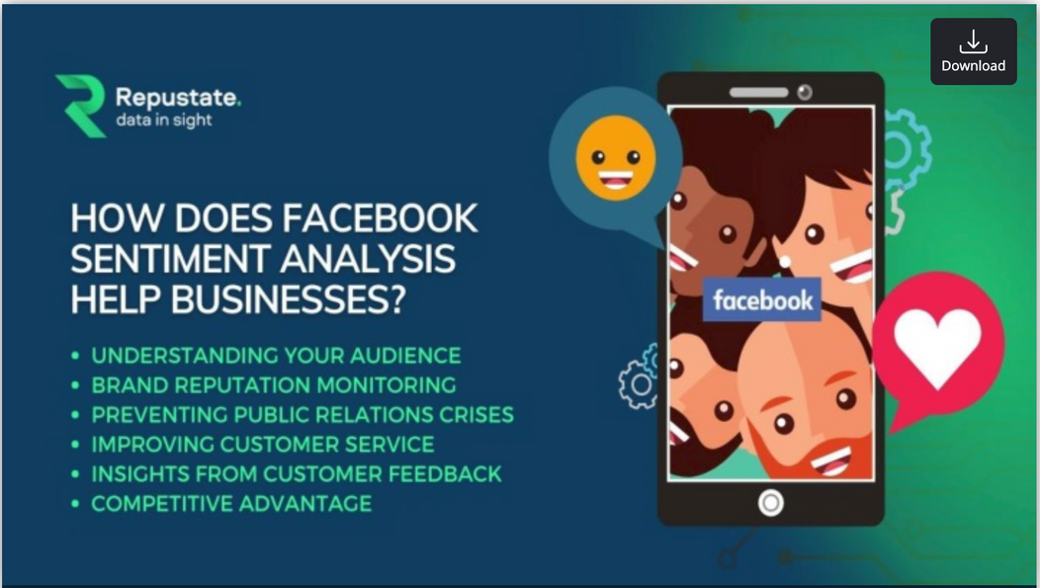
OBJECTIVE
Sentiment analysis of Facebook data involves the automated process of understanding opinions expressed in posts and comments on the platform.
This analysis is crucial for projects seeking to gauge public sentiment, customer feedback, or user reactions.
Techniques from Power BI,Python,MS Excel Dashboards are commonly employed to extract insights from the vast amount of textual data on Facebook.
Methods include Data extraction, Data preprocessing,Data Cleaning and Visualizations.

Slide 4
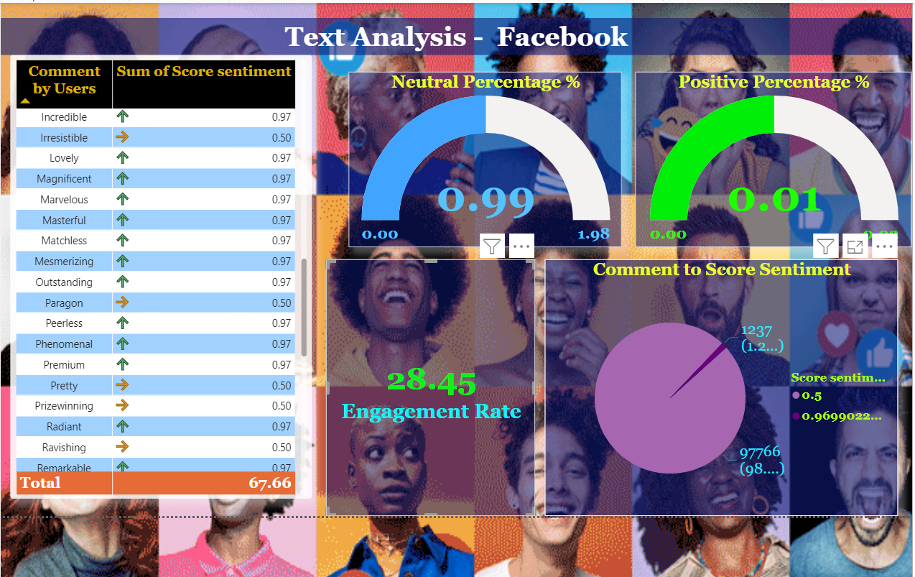

Slide 5
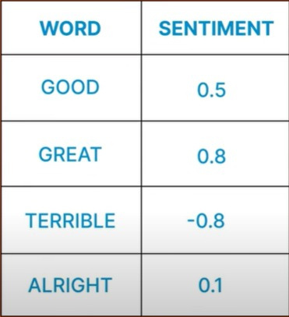

Slide 6
TEXT ANALYSIS OF COMMENTS
The engagement rate is calculated as the total number of interactions your content receives divided by your total number of followers, multiplied by 100%.
By selecting all the year we are seeing
Positive-1.25%(1.24k)
Neutral-97.77k(98.75)
Positive count -1237

Slide 7
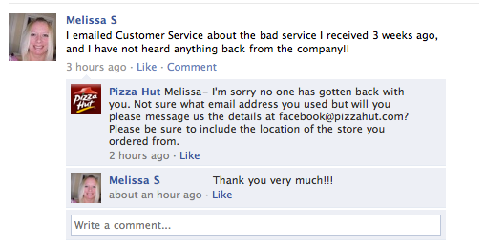
Negative Comment

Slide 8
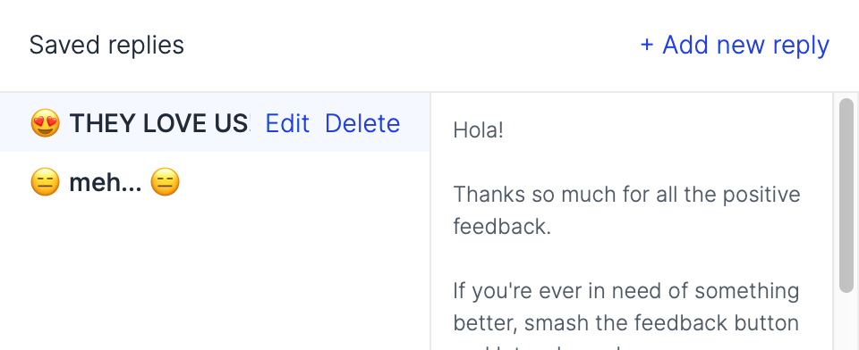
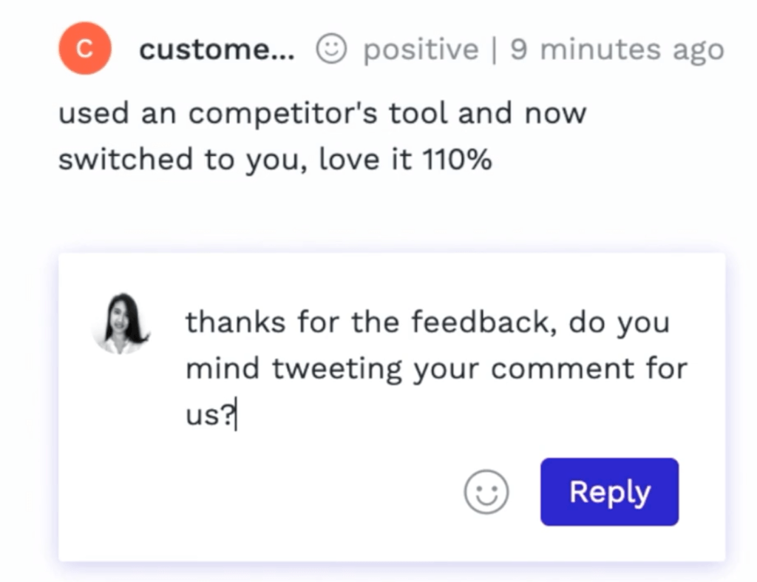
Positive Comments

Slide 9
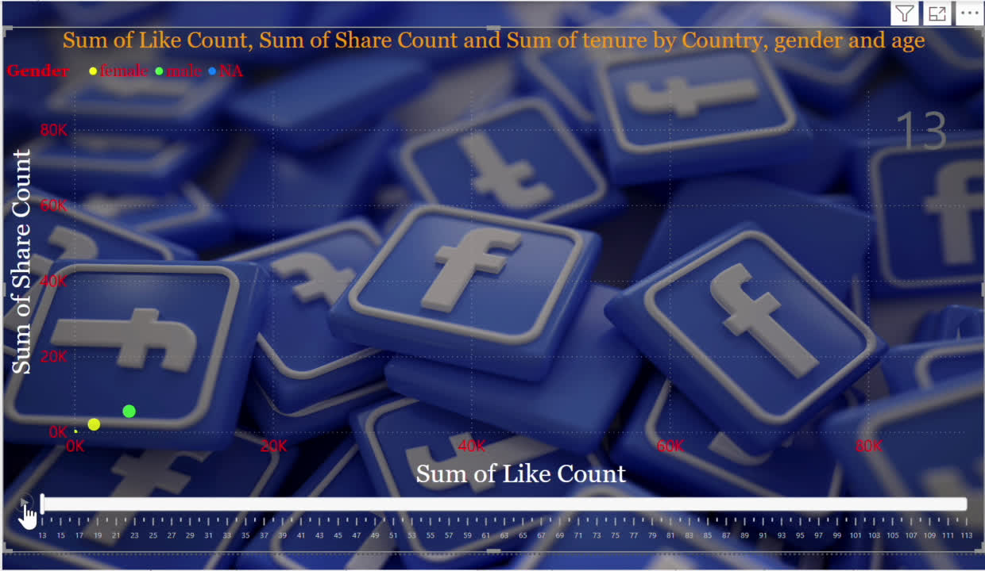

Slide 10
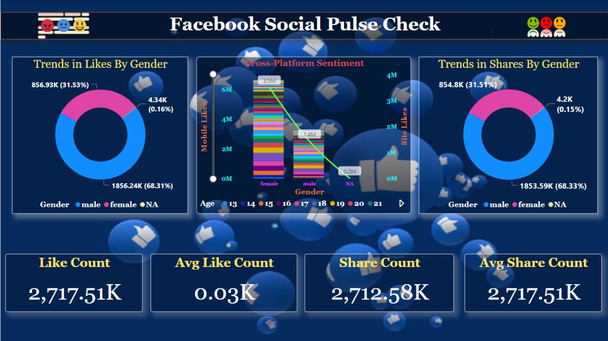

Slide 11
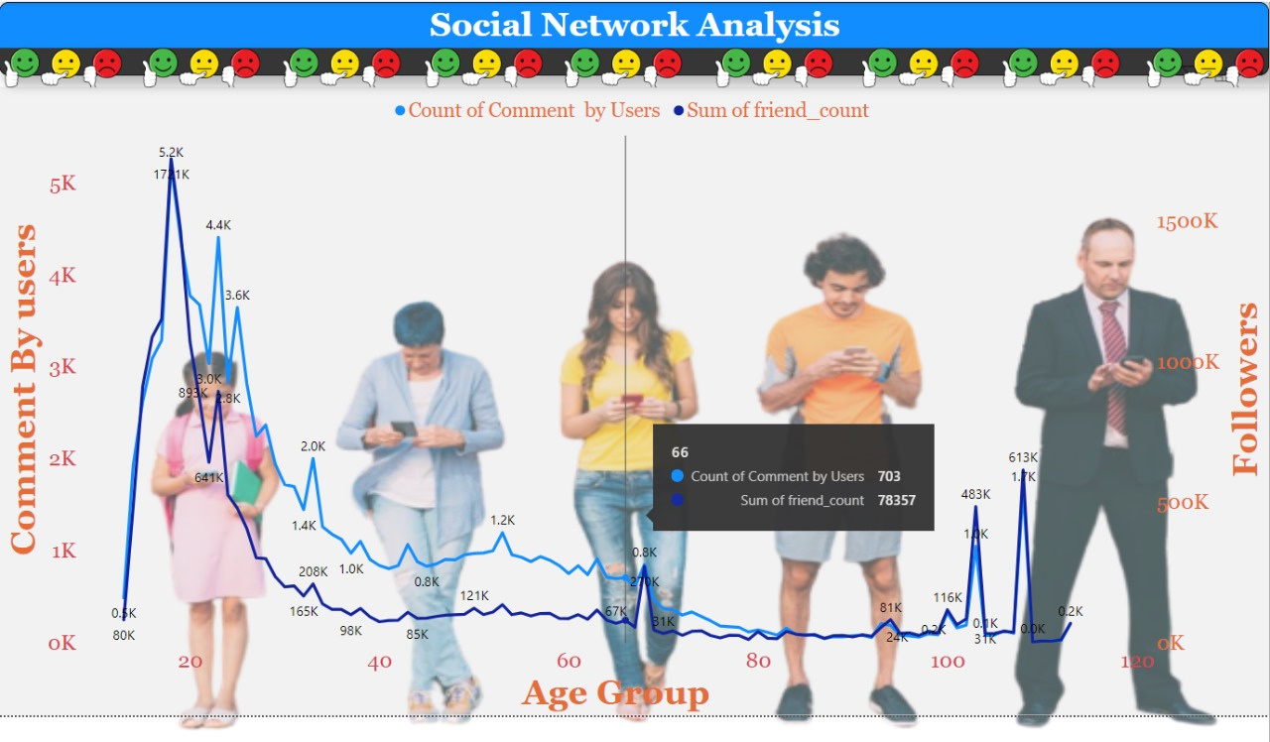

Slide 12
FACEBOOK SOCIAL PULSE
SOCIAL NETWORK ANALYSIS
There are more males than females for an average post.
There are 75% of male likes and 25% of female likes.
There is a greater number of females who are interested in posts on mobile to like when compared to males.
Female likes for a post are an average of 3.4 million, whereas male likes are around 1.4 million.
So females are more interested in liking posts.
There is more share for an average post by males compared to that of females, no matter whether the post has a sad or happy message.
So men are more interested in sharing the posts.
Age group below 20 are more interested in giving comments.
The age group 80 to 100 is less interested in giving comments.
Age between 40 to 60 are showing a typical interest in sharing the comments.
We are also getting the most number of follow requests at the age of 20 and least number of requests at the age of 80 to 100yrs.
We noticed that in the age grp of 80 to 100 the people are least interested in giving a comment and friend count.

Slide 13
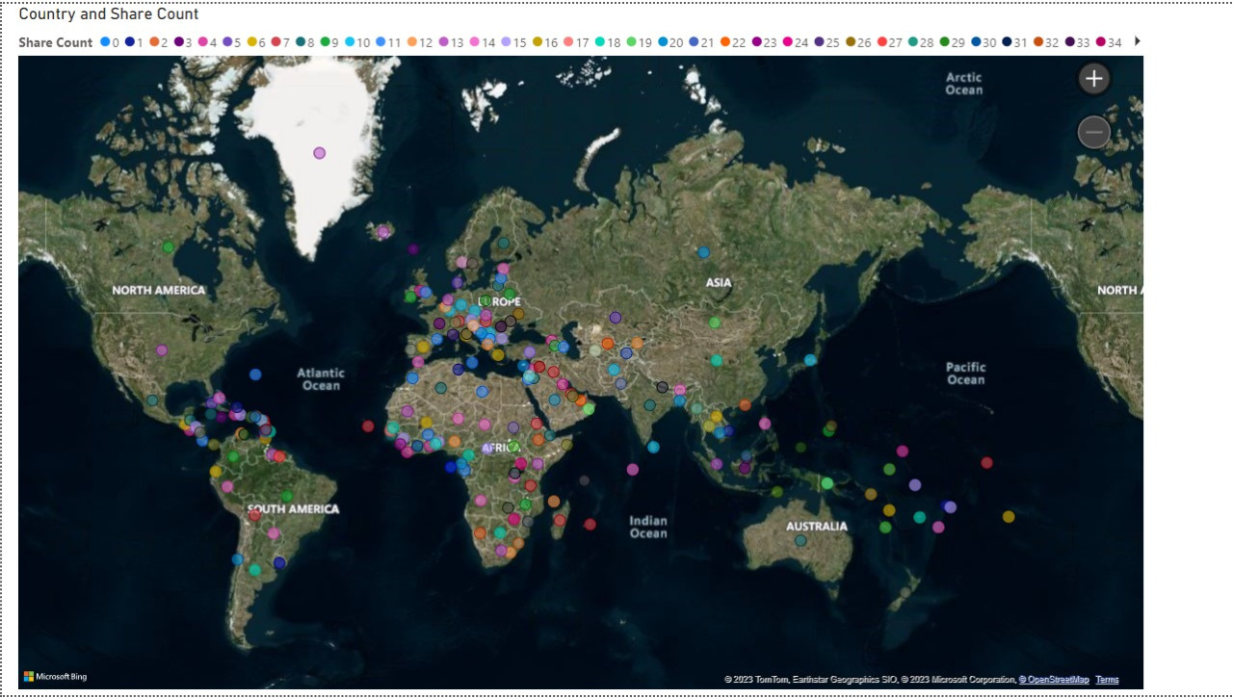
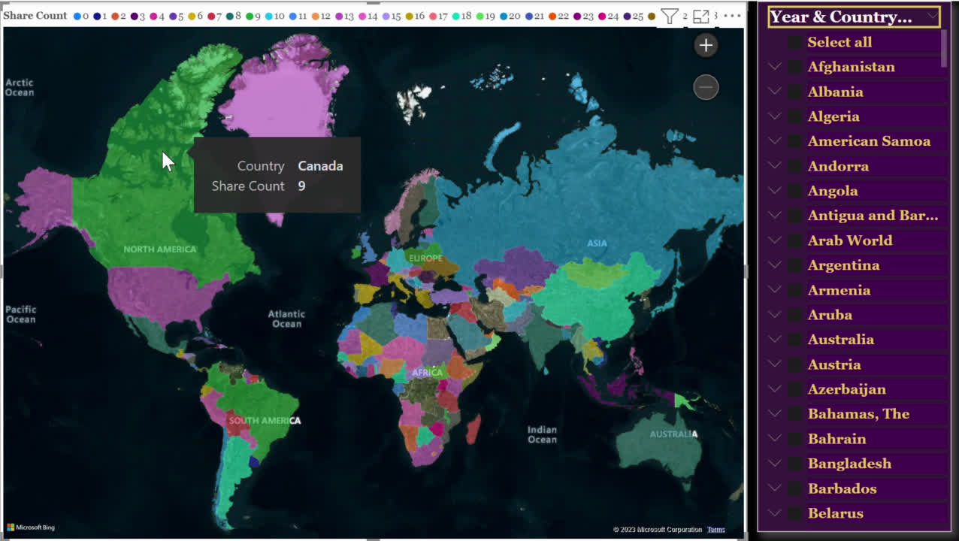

Slide 14
Share Count VS Country
Country on Location,Share Count on Legend fields of Map Visualisation
A slicer contains country and date of birth to select, particularly about the share count.
When we move the mouse to each country on the map, we see the share count and country name.
0 shares in 5 countries Montenegro, North America,Morocco,IDA blend, and South Asia (IDA and IBRD)
Most shares are in sub-Saharan Africa (969).
Similar shares in North, West, and East Asia

Slide 15
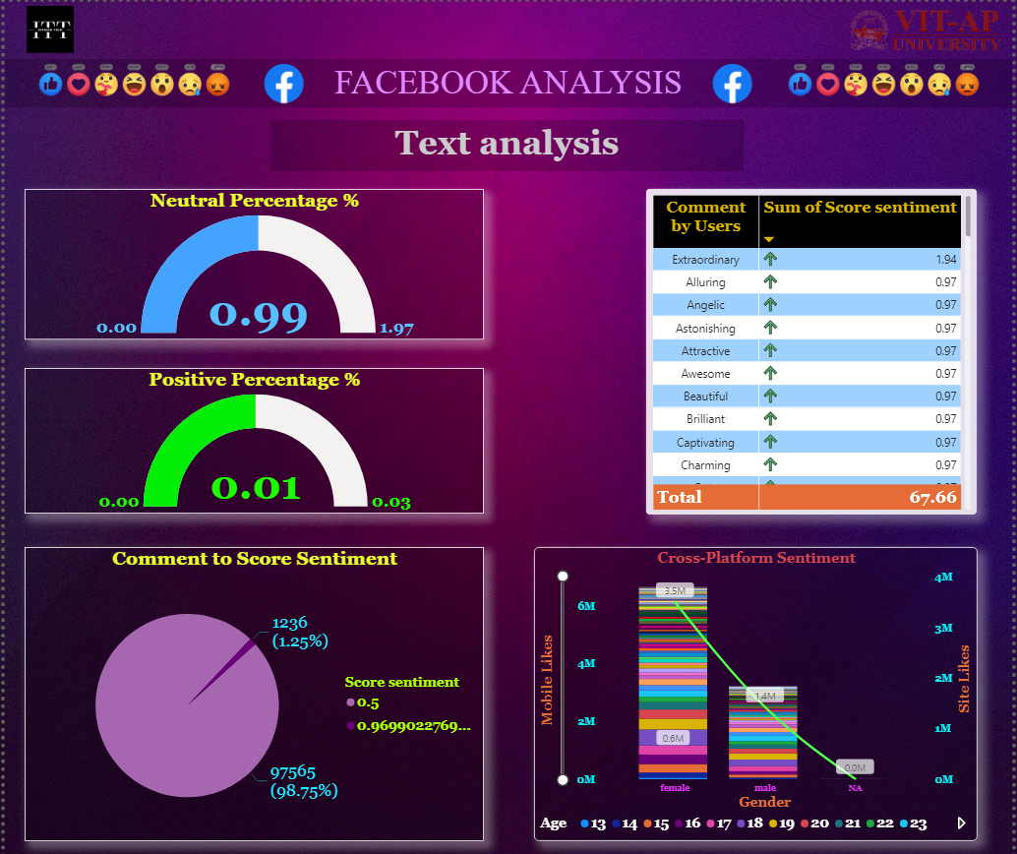
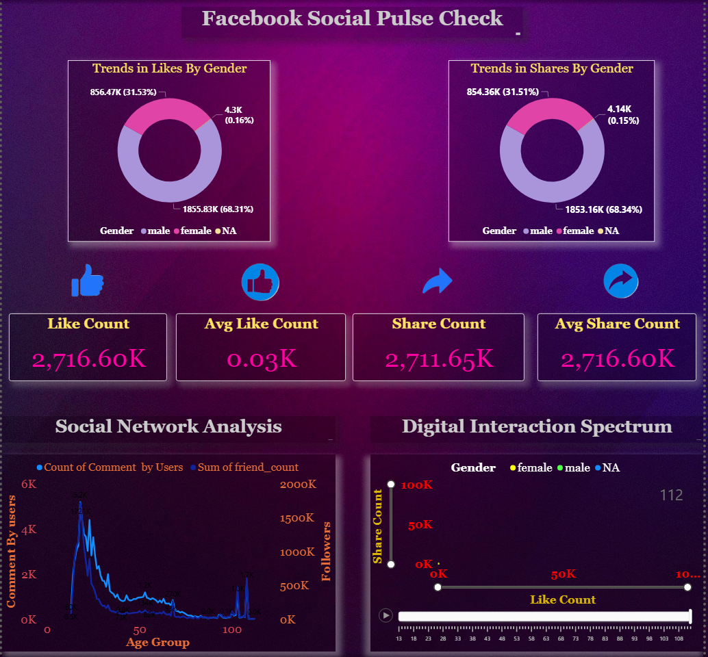
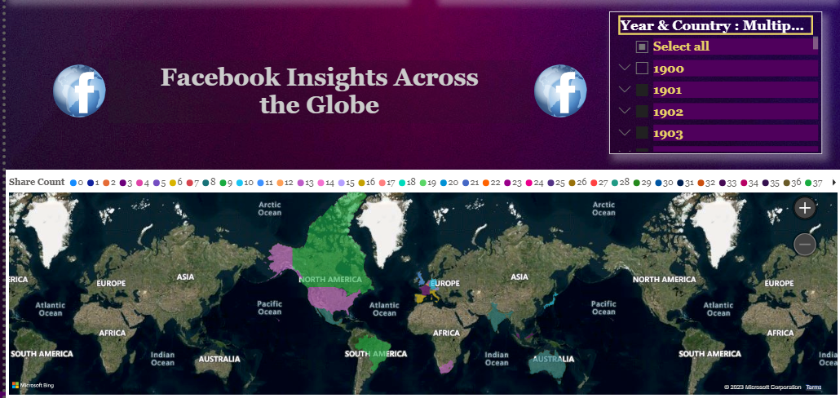

Slide 16
Analysis using Python
The process of retrieving specific information or data from various sources, such as databases, websites, documents.
Data Extraction
The process of fixing or removing incorrect, corrupted, incorrectly formatted, duplicate, or incomplete data within a dataset..
Data Cleaning
To measure the sentiment or emotional tone of a piece of text. These scores expresses as positive, negative, or neutral sentiments.
Polarity Scores

Slide 17
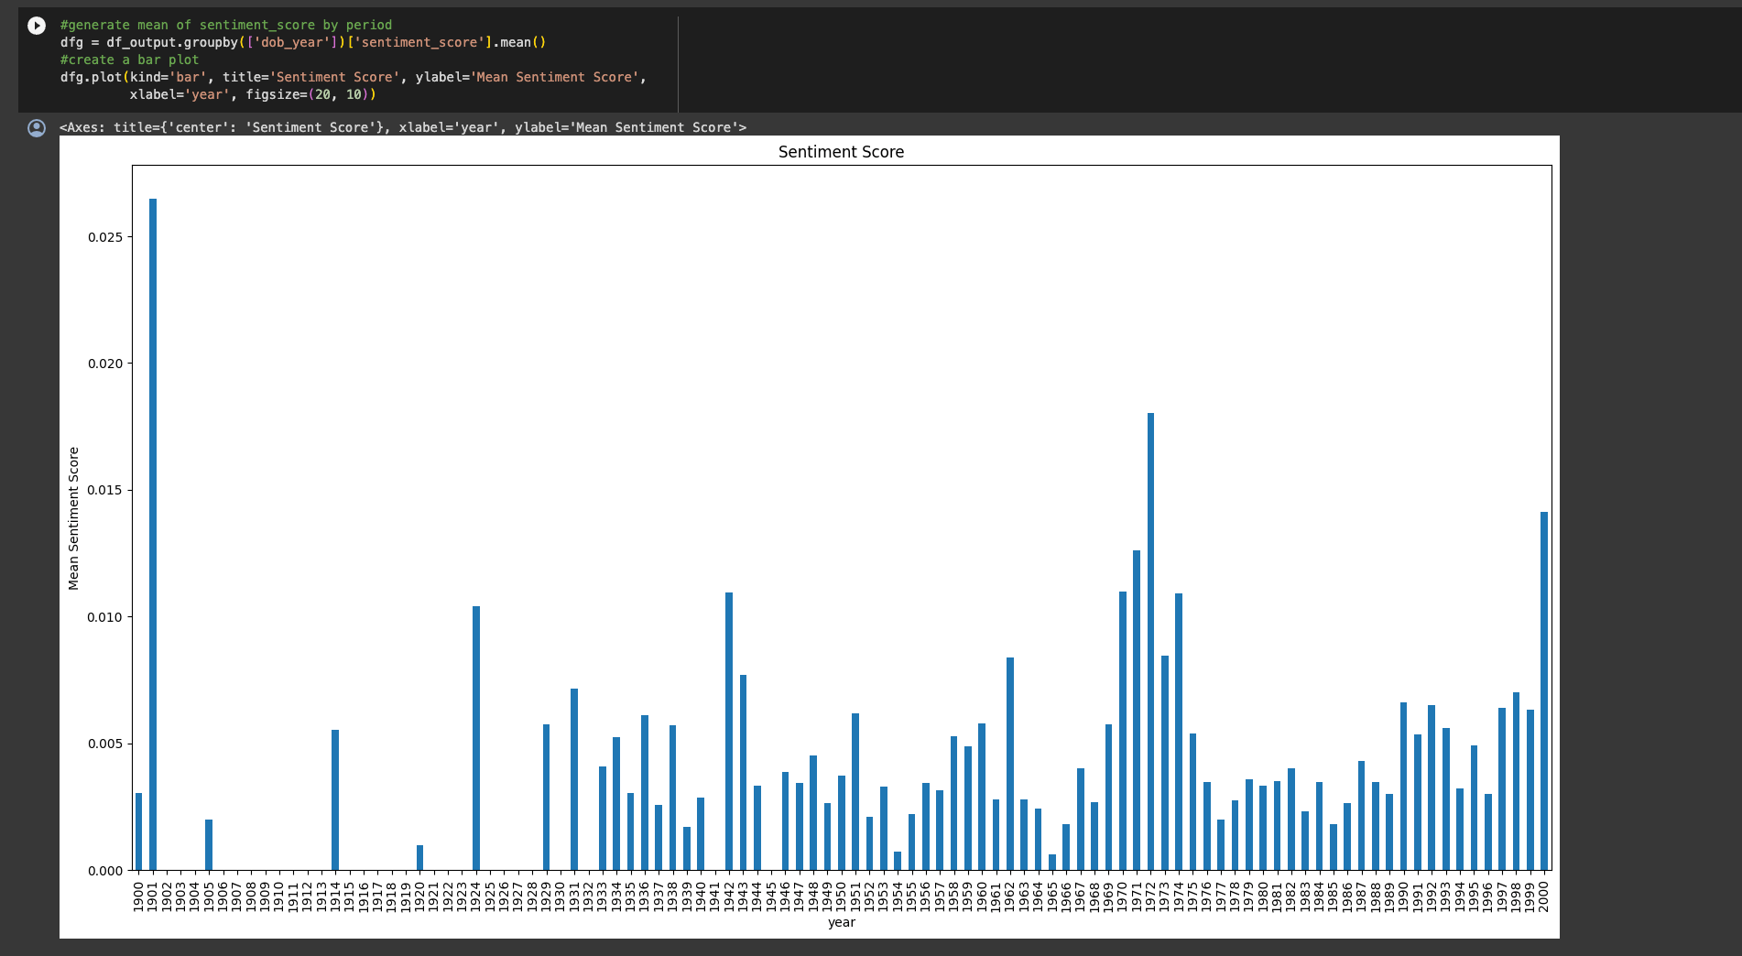
Year Vs Mean Sentiment Score

Slide 18
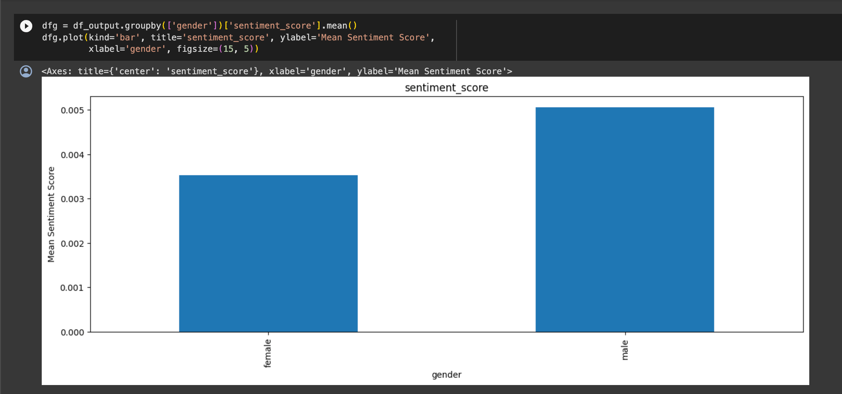
Gender Vs Mean Sentiment Score

Slide 19
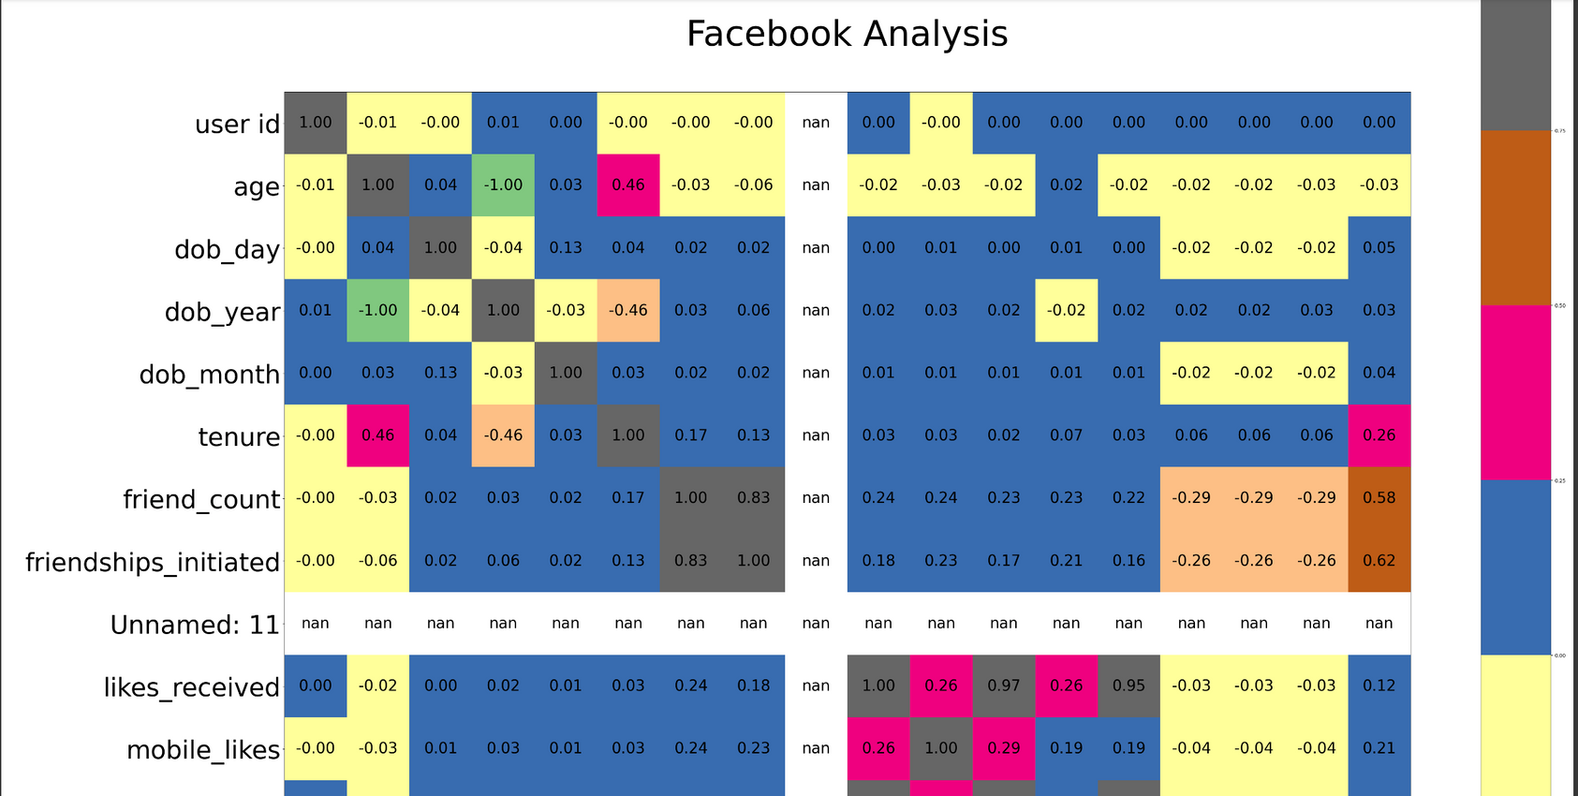
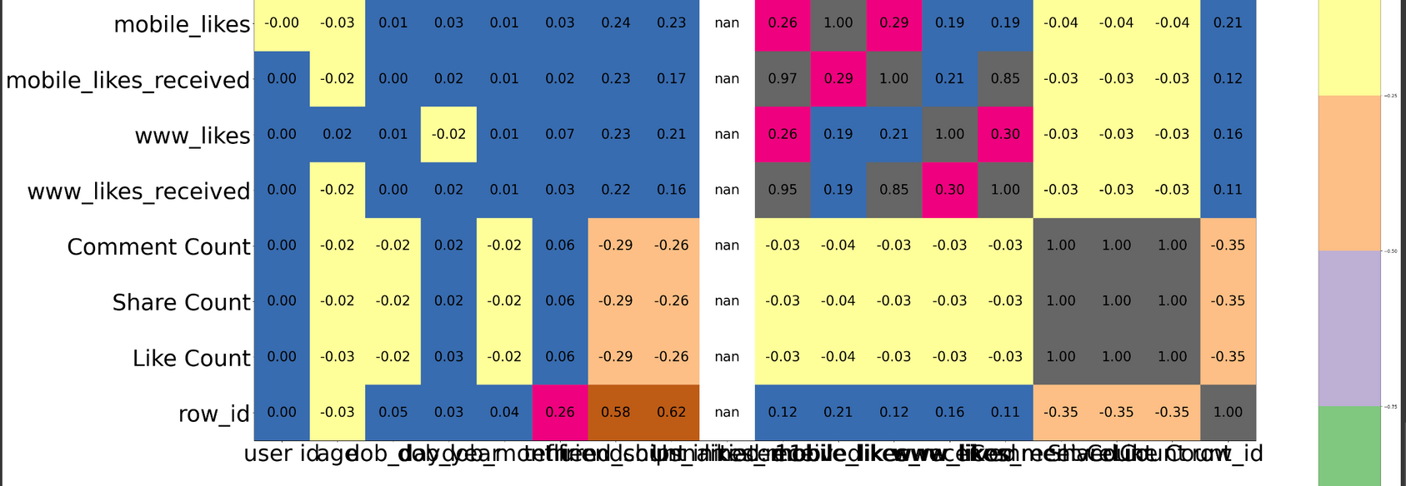

Slide 20
Recomendations
Share positive news stories and achievements to improve the company's public image.
Tailor marketing messages, offers, and services to individual customer preferences.
Embrace technology trends to enhance customer experiences and operational efficiency.
Ensure that employees are trained to adapt to changing customer needs.
Customize marketing efforts for different segments as needed.
Provide contact information or ask the customer to reach out privately to discuss the issue further. This helps prevent a back-and-forth exchange in a public forum and allows for a more personalized resolution.

Slide 21
Thank
21BCE9163-SIGHAKOLLI SNEHA
21BCB7089-K ANIL KUMAR REDDY
21BCE8526-M SAI JYOTHI SWARROP
21BCE9822-G V S S DEEPAK
21BCE9414-CH MANASA
21BCE7632-NARAMGARI SAI LASYA
you!

